Slide 1
TRUEMARK
MEETING WITH RILEY
SYSTEM READINESS
Prove the backend works
Walk through the customer journey
Walk through customers, account creation, logins, tracking, and the connection between the backend and the
customer-facing website. Show how changes reach the front end.
Know where everything lives
Explain where everything is saved, including customer records, account information, orders, tracking, site
content, and agent information.
Review the latest updates
Review our latest backend updates, what is already working, and what remains unfinished or disconnected.
TRUEMARK / SYSTEM READINESS
01 / 20

Slide 2
TRUEMARK
MEETING WITH RILEY
SYSTEM READINESS
Understand the connections
Map the system
Show me the complete system and data flow: what runs on the front end, what runs on the backend, what
Supabase stores or controls, what GitHub contains, and how a change moves from the code to the live site.
Show me where to make changes
Show me where I should make future changes, how GitHub and Supabase should be updated together, and
which changes can affect customer data, logins, orders, tracking, website content, or the AI brain.
Give me a usable handoff
Leave me with a simple written map of the system, the accounts and access I need, the changes I can safely
make myself, and the changes Riley should review before they go live.
TRUEMARK / SYSTEM READINESS
02 / 20

Slide 3
TRUEMARK
MEETING WITH RILEY
SYSTEM READINESS
Add features with confidence
A repeatable update process
Give me a safe process for adding features: create a separate GitHub branch, preview and test the change,
review any Supabase database or permission changes, approve the update, deploy it, and verify the live
result.
Checks and balances
Set up checks and balances so I do not accidentally break the live site or data. Cover backups, database
migrations, access permissions, automated checks, a staging or preview environment, deployment approval,
monitoring, and rollback.
TRUEMARK / SYSTEM READINESS
03 / 20

Slide 4
TRUEMARK
MEETING WITH RILEY
SYSTEM READINESS
Make the agents useful
Customer agent
Connect the customer agent to the TrueMark brain so it can learn and improve over time, use its capabilities to
help customers thoughtfully, and avoid repeating the same canned answers. Agree on how learning and
memory will work.
Partner agent
Make the partner agent useful and capable of taking action, beyond answering from fixed chatbot data.
Review the partner capabilities we already discussed and confirm they are connected.
My personal agent
My personal agent already has a running version. Review its existing setup and connections. Demonstrate a
complete task for the customer and partner agents and confirm their data access and permissions.
TRUEMARK / SYSTEM READINESS
04 / 20

Slide 5
TRUEMARK
MEETING WITH RILEY
SYSTEM READINESS
Finish the connections
Analytics
Connect Google Analytics and confirm that tracking works.
Email flows and the email agent
Review email flows and the email-flow agent we discussed. Identify the software, triggers, and backend
connections needed.
Website URL and payment processing
Confirm the website URL we need so we can move forward with a payment processor. Identify anything still
needed before we can apply or connect it.
TRUEMARK / SYSTEM READINESS
05 / 20

Slide 6
TRUEMARK
MEETING WITH RILEY
OPERATIONS
Shipping status should reflect reality
01 Packed
03 Shipped
Print a label and mark the order “Packed.”
Automatically mark the order “Shipped” once UPS or
FedEx scans the package and tracking confirms the
02 Dropping off
handoff.
Use “Dropping off” for the stage before the carrier
confirms shipment, instead of marking it “Shipped” too
Mobile shipping desk
early.
Fix the mobile shipping desk view where content is cut
off below the fulfillment queue.
TRUEMARK / OPERATIONS
06 / 20

Slide 7
TRUEMARK
MEETING WITH RILEY
OPERATIONS
Refine the Command Center
Order states
Lots and inventory
Orders and overview: remove the “Placed” state
Lots and certificates: refine lot management and
because the intended flow treats placed orders as paid.
certificate tracking views. Products and inventory:
Confirm the payment behavior before changing the
improve inventory synchronization and management.
status logic.
Customer messages
Risk review
Combine inboxes and allow messages to customer
Risk review: set up automatic review triggers for large
accounts directly from the dashboard.
orders. Agree on the quantity thresholds.
TRUEMARK / OPERATIONS
07 / 20

Slide 8
TRUEMARK
MEETING WITH RILEY
OPERATIONS
Improve the business tools
Research Blog
Rename “Journal” to “Research Blog.” Make it possible to publish new posts so they appear automatically and
manually edit existing copy.
Profit planner
Add testing costs, affiliate costs, and discount percentage. Agree on how each affects the profit calculation.
TRUEMARK / OPERATIONS
08 / 20

Slide 9

TRUEMARK
MEETING WITH RILEY
STOREFRONT
Polish the homepage
Brand and hero copy
“TRUEMARK” replaced “Verified.” Move it slightly behind the vials,
as in the original design. Keep “RESEARCH PEPTIDES” beneath
“True precision” and replace remaining “Research Compounds”
wording.
Shop Peptides button
“Shop Peptides” replaced “View catalog.” Make the button reappear
below the “Organized by compound class” section.
Promotions
Clean up the placement of the free-shipping offer and “10% off your
first order.” Use the updated $200 free-shipping threshold
consistently; the reference screenshot still shows $150.
ORIGINAL ISSUE REFERENCE
TRUEMARK / STOREFRONT
09 / 20

Slide 10
TRUEMARK
MEETING WITH RILEY
STOREFRONT
Make the collection easy to explore
Look Closer
Reliable desktop animation
Look Closer: skip step 01 and go straight to step 02 so
Fix the desktop compound-class animation. It moves up
the feature shows its function instead of only zooming in
and down and currently needs an exact scroll position to
on the vial.
display and work properly.
Clickable classes and a continuous carousel
An intuitive mobile experience
Compound classes: make the peptides clickable so they
Add animation on mobile when scrolling down from the
lead to the relevant categories. Add continuous carousel
homepage. Review the spotlight collection carousel: I
scrolling in class order and automatic sliding.
like it on desktop, but it is not intuitive on mobile.
TRUEMARK / STOREFRONT
10 / 20

Slide 11
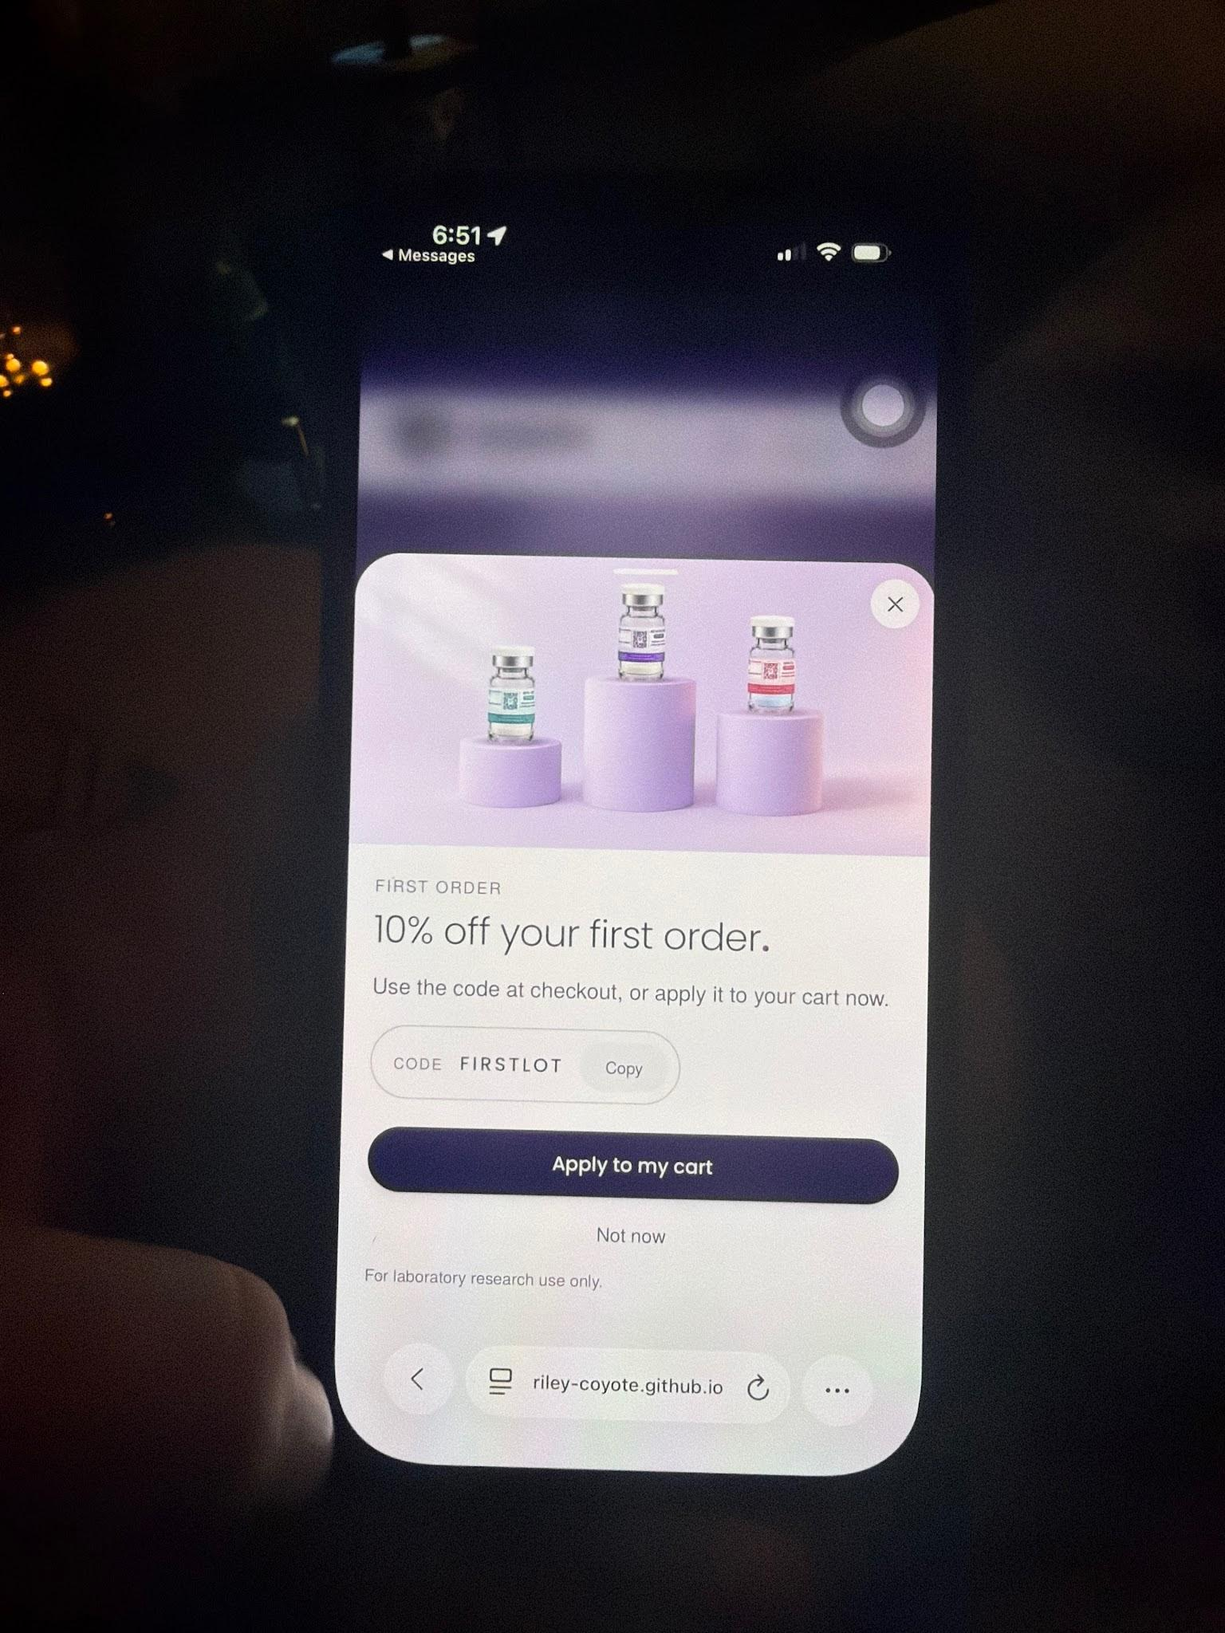
TRUEMARK
MEETING WITH RILEY
STOREFRONT
Let visitors scroll before the offer
First-order popup
Show this popup only after the visitor has scrolled down a little.
Agree on the point at which it should appear.
Timing to confirm
Agree on how far visitors should scroll before the offer appears.
ORIGINAL ISSUE REFERENCE
TRUEMARK / STOREFRONT
11 / 20

Slide 12
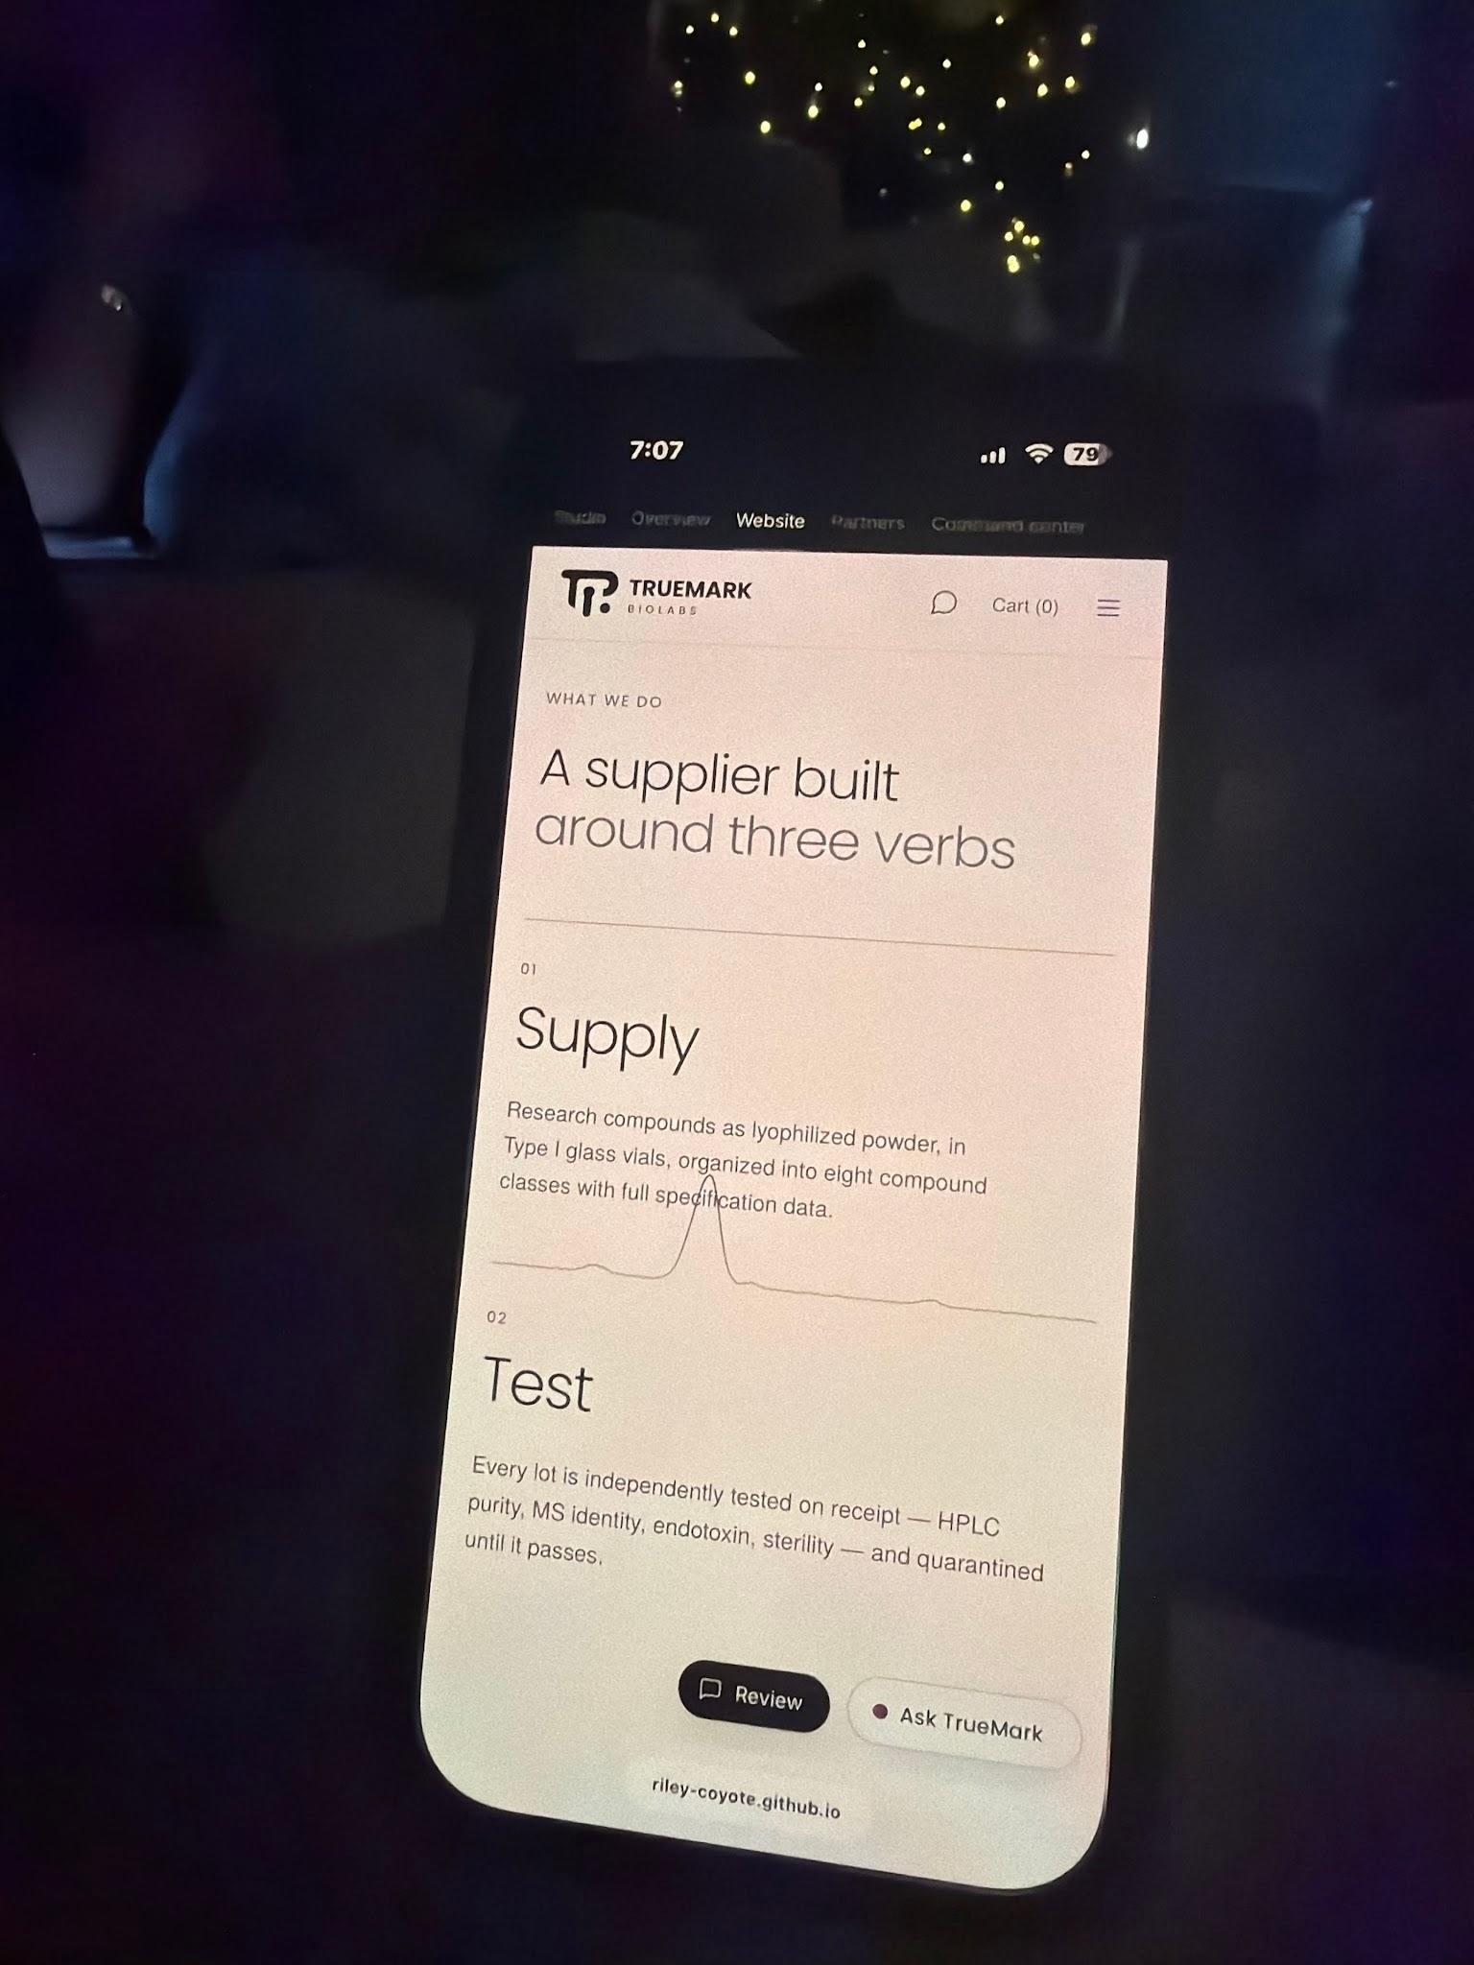
TRUEMARK
MEETING WITH RILEY
STOREFRONT
Fix the mobile About page
Keep the animation clear of the copy
Resolve the layout and function bugs on the About page. The purity
animation overlaps the text on mobile.
ORIGINAL ISSUE REFERENCE
TRUEMARK / STOREFRONT
12 / 20

Slide 13
TRUEMARK
MEETING WITH RILEY
SHOPPING EXPERIENCE
Make account creation clearer
Research account flow
Discuss the research account application flow in depth and rethink how the overall process should work.
First visit and verification
Review the first-visit research guidelines and verification flow, including how the guidelines open and how the
CAPTCHA works.
Application wording
Change the account application action from “Apply” to “Create.”
TRUEMARK / SHOPPING EXPERIENCE
13 / 20

Slide 14
TRUEMARK
MEETING WITH RILEY
SHOPPING EXPERIENCE
Clarify products and verification
Vial options and discounts
GLP-1 names
Show 1-vial, discounted 2-vial, and discounted 3-vial
Change the GLP-1 names. Confirm the exact
options. Confirm the discount amounts.
replacement names before making the edits.
Show every purity result
Verify animation
For stacks, show all relevant purity results on the
Revisit the Verify page animation. I preferred the original
product page and the Verify page. Remove the limitation
animation, but want it to fit the current visual style.
that prevents all purity percentages from reaching the
main site.
TRUEMARK / SHOPPING EXPERIENCE
14 / 20

Slide 15
TRUEMARK
MEETING WITH RILEY
SHOPPING EXPERIENCE
Make the cart feel polished
Consistent mobile and desktop behavior
Use the same add-to-cart popup on desktop as on mobile. Clean up the cart and add-to-cart animations on
mobile and desktop so the movement, timing, and confirmation feel polished and consistent.
Cart box and progress bar animations
Revamp the cart box, popup motion, and progress bar animations on mobile and desktop. Mimic the
homepage slider, with smooth progress toward free Bac Water at $75 and free shipping at $200. Use the
end-to-end lot explanation as the progress-bar styling reference.
Shipping insurance
Add shipping insurance to the cart, enabled by default with an option for the customer to turn it off.
TRUEMARK / SHOPPING EXPERIENCE
15 / 20

Slide 16
TRUEMARK
MEETING WITH RILEY
SHOPPING EXPERIENCE
Make the rewards easy to understand
Free Bac Water at $75
Loyalty points
Unlock free Bac Water at $75 and show progress
Integrate the loyalty points system and agree on the
toward this reward in the cart.
earning and redemption rules.
Free shipping at $200
Confirm the remaining details
Use $200 throughout the cart, homepage promotions,
Agree on the account and first-visit flow, GLP-1
and checkout. Update older $150 free-shipping wording.
replacement names, vial discounts, and the Verify
animation reference. Reward thresholds are $75 for free
Bac Water and $200 for free shipping.
TRUEMARK / SHOPPING EXPERIENCE
16 / 20

Slide 17
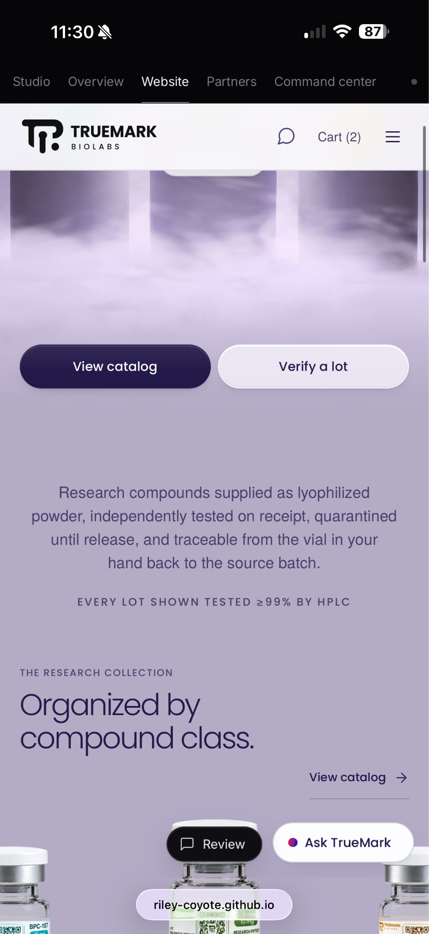
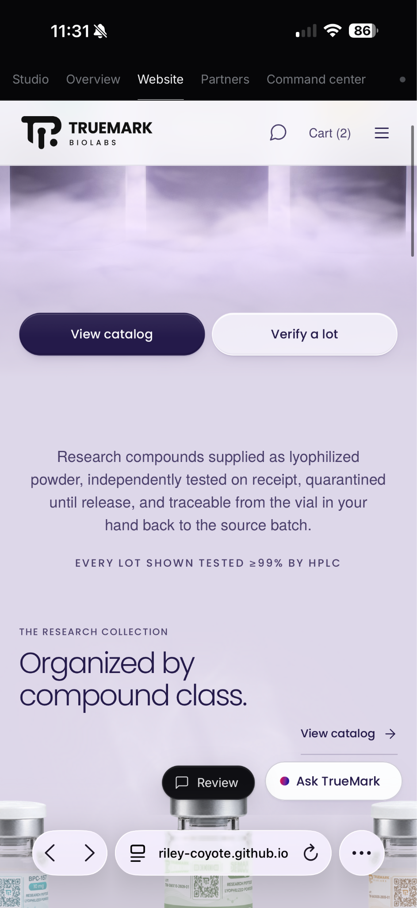
TRUEMARK
MEETING WITH RILEY
VISUAL BUGS
Smooth out the background
Refresh and scroll flicker
Fix the background changing or jumping from dark to light
on initial refresh and while scrolling.
Continuous light movement
Make the background hue and light effect move smoothly
during scrolling, as it does on desktop. It currently jumps
after scrolling stops.
Compound-class transition
Check the transition into the compound-class section
alongside the desktop animation fix in the homepage
section.
ORIGINAL ISSUE REFERENCE
TRUEMARK / VISUAL BUGS
17 / 20

Slide 18
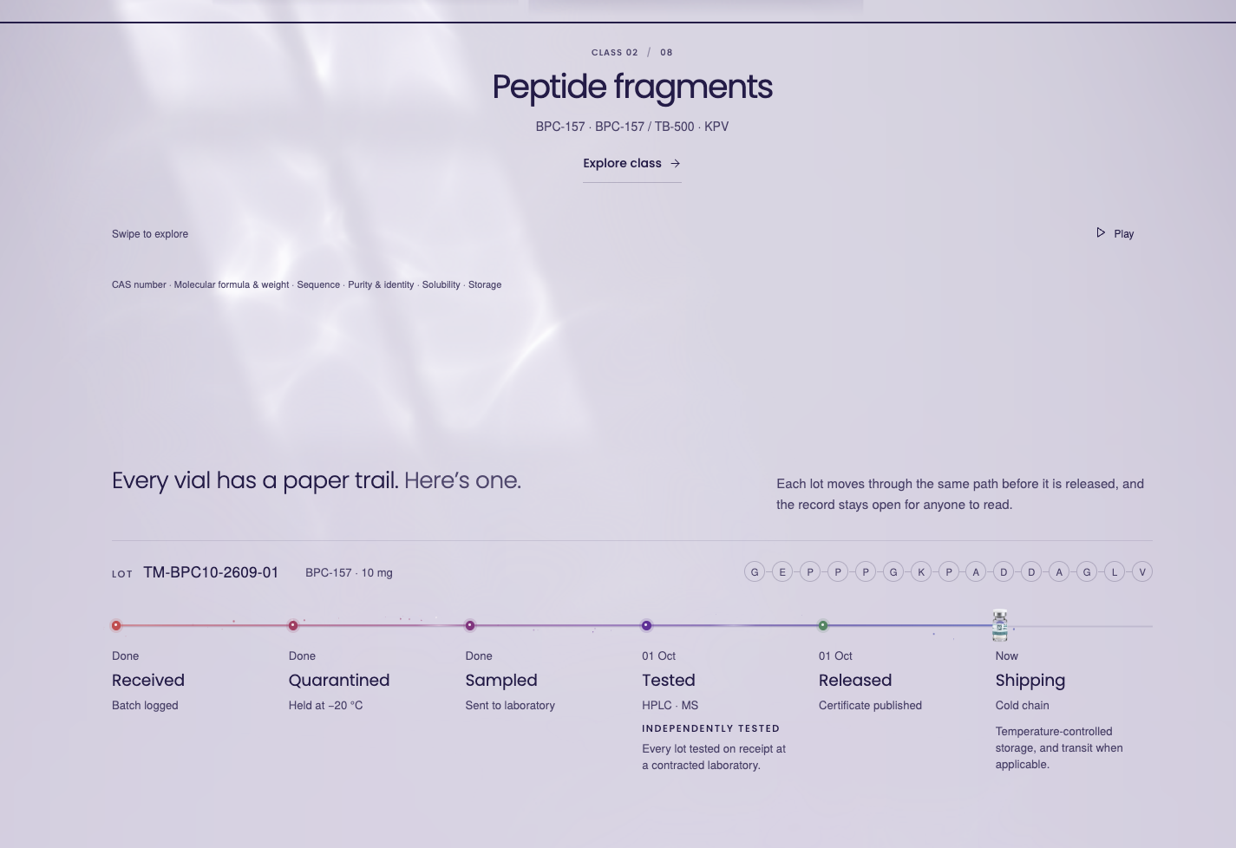
TRUEMARK
MEETING WITH RILEY
VISUAL BUGS
Remove unexpected empty space
Spacing across pages
Fix empty-space glitches across
pages, including the Coenzymes
& cofactors section.
ORIGINAL ISSUE REFERENCE
TRUEMARK / VISUAL BUGS
18 / 20

Slide 19
TRUEMARK
MEETING WITH RILEY
VISUAL BUGS
Check navigation and Windows behavior
Returning to the homepage
The homepage loads correctly on the first visit. After opening another page, returning home through the
navigation logo or the browser Back button produces a glitchy load. Reproduce and fix both return paths.
HP Envy on Windows
On my mom’s HP Envy, the site shows the desktop layout and navigation, but behaves as though it loaded the
mobile version: no animation on scroll, a carousel that is not continuous, and a glitchy background. Investigate
why these mobile-style issues appear in the desktop view. Confirm the browser, affected pages, and steps to
reproduce.
TRUEMARK / VISUAL BUGS
19 / 20

Slide 20
TRUEMARK
MEETING WITH RILEY
DISCUSSION
Questions to settle with Riley
Working today
Payment setup
Which parts of the backend and integrations can we
What website URL and remaining setup are needed for
demonstrate working now, and which still need to be
payment processing?
built or connected?
Business rules
Agent behavior
What exact settings should we use for shipping
How will the customer agent learn through the TrueMark
statuses, large-order reviews, discounts, rewards, and
brain and give more thoughtful help? Which previously
profit calculations?
discussed partner actions will it perform, and how does
the existing personal agent connect?
TRUEMARK / DISCUSSION
20 / 20

